Slide 1

DELIVERY AND DEVELOPMENT
BEST PRACTICES

Slide 2
HOUSE RULES
Close all laptops unless needed for discussion.
No use of cellphones during the discussion unless there is an emergency.
Questions can be raised during the lecture.
01
02
03

Slide 3
OBJECTIVES
01
02
03
RPA Agile teams will be aware of the RPA CoE Governance Model
04
Comply with the Delivery and Development Best practices guidelines
Manage the development phase in accordance with the Governance Model
Prepare necessary documents for the Delivery and Development Phase

Slide 4
ATTENDEES
01
02
03
RPA Developers
04
RPA Testers / TCOE
Solutions Designer
Scrum Masters and Product Owners (Optional)

Slide 5

RPA OVERVIEW
A short primer to RPA…

Slide 6
RPA OVERVIEW
WHAT IS RPA?
BENEFITS OF RPA
COMPUTER-CODED
SOFTWARE
01
PERFORMS HIGH-VOLUME REPETITIVE TASKS
RULE-BASED ROBOT
02
INCREASE MANPOWER EFFICIENCY
SCALABLE
03
FASTER THAN AN FTE
CROSS FUNCTIONAL &
CROSS APPLICATION
04
REDUCES THE BUSINESS COSTS
SCHEDUL-TRIGGERED
OR MANUALLY TRIGGERED
05
INCREASES BUSINESS ACCURACY
Reference: The Creative Studio at Deloitte, London. J13988
Notes:
WHAT IS RPA?
It is a computer-coded software that does what a person can do in a computer.
It is purely RULE BASED, meaning, it is greatly dependent on how we describe the process to it.
It is scalable. It can be multiplied based on the need on the process and optimized to increase it’s productivity.
It is Cross Functional because robots can work with each other and Cross Application Macros because it can open 2 or more applications based on the need in the process.
It can be scheduled or manually triggered.

Slide 7
RPA OVERVIEW
RPA is NOT…
…a walking, talking robot.
1
2
…a physically existing machines processing tasks.
…an Artificial Intelligence.
4
3
…a voice recognition software or a chat bot.
Reference: The Creative Studio at Deloitte, London. J13988

Slide 8
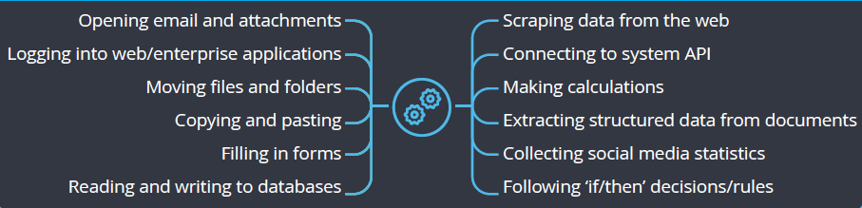
RPA OVERVIEW
What RPA can do are the following…
Reference: The Creative Studio at Deloitte, London. J13988

Slide 9










RPA OVERVIEW
What applications it can control?

Slide 10
RPA OVERVIEW
UNATTENDED VS ATTENED ROBOTS
UNATTENDEDROBOT
are robots that are scheduled to perform certain tasks
ATTENDED
ROBOT
are robots that needs human intervention to start or stop the workflow or process

Slide 11
RPA OVERVIEW
UNATTENDED VS ATTENED ROBOTS
UNATTENDEDROBOT
Recommended for a process that can run continuously without any intervention.
Highly suggested for processes that needs Manual intervention after an automation
ATTENDED
ROBOT

Slide 12
RPA OVERVIEW
DISPATCHER AND PERFORMER
PERFORMER ROBOT
Robot that performs the main process.
Robot that queues transaction items for the performer to process.
DISPATCHER
ROBOT

Slide 13
RPA OVERVIEW
DISPATCHER AND PERFORMER
PERFORMER ROBOT
Takes transaction items in queue from the Orchestrator to process the item.
Upload the information of the Transaction Items to the Orchestrator in a queue manner.
DISPATCHER
ROBOT

Slide 14
RPA OVERVIEW
DISPATCHER AND PERFORMER
PERFORMER ROBOT
Always recommended on the process.
Advisable if the process does not have queueing mechanism or application.
DISPATCHER
ROBOT

Slide 15

RPA OVERVIEW
UiPATH one of the leading vendors for Robotic process Automation which provides a software platform for automation of tasks.
UiPath
Studio
UiPath
Orchestrator
UiPath
Robot
Development
Testing
Scheduling
Monitoring
Running
Executing

Slide 16
COURSE OUTLINE
01
Governance Model Overview
02
Development Best Practices
03
Agile Life Cycle
04
Documentation Workshop
05
Mini Quizzes or Post Exam
Notes:
Things to be discussed:
Governance Model
Development Practices
Agile Lifecycle
Documentation Workshop
Mini Quizzes

Slide 17
COURSE OUTLINE
01
Governance Model Overview
02
Development Best Practices
03
Agile Lifecycle
04
Documentation Workshop
05
Mini Quizzes or Post Exam

Slide 18
RPA CoE ORGANIZATION STRUCTURE
CoE Business
CoE Core/ISG
Head of Function
Head of RPA
Continuous Improvement Manager
Delivery Manager
Platform Manager
RPA Evangelist
Process Owner (s)
Product Owner
Scrum Master
Solution Designer
RPA SDM / DevOps Coach
Platform SDM(s)
Business Process SME (s)
Process Analyst
RPA Lead Developer
Process Analyst
Scrum Master
Infra Squad Implementation
RPA L1
DevOps Engineer
Infra Squad Ops
Developer
Tester
RPA Lead Developer
RPA Orchestrator Ops Team
Optional for business
Developer
Tester

Slide 19
RPA CoE ORGANIZATION STRUCTURE
CoE Business
CoE Core/ISG
Head of Function
Head of RPA
Continuous Improvement Manager
Delivery Manager
Platform Manager
RPA Evangelist
Process Owner (s)
Product Owner
Scrum Master
Solution Designer
RPA SDM / DevOps Coach
Platform SDM(s)
Business Process SME (s)
Process Analyst
RPA Lead Developer
Process Analyst
Scrum Master
Infra Squad Implementation
RPA L1
DevOps Engineer
Infra Squad Ops
Developer
Tester
RPA Lead Developer
RPA Orchestrator Ops Team
Optional for business
Developer
Tester
Notes:
There will be 2 types of Delivery team:
Those that are internal to business;
Those that are inside the CoE Core

Slide 20
RPA CoE
PHASES
02
04
06
DISCOVERY
IMPLEMENTATION
BENEFITS
REALIZATION
Demand Management Process Definition
Delivery
Deployment
01
03
05
IDEATION
SOLUTIONING
OPERATIONS
Transition to Automation
Opportunity Selection
Demand Management (Dev)
Pre-requisite for Dev
Agile Lifecycle
Operations
Support

Slide 21
IDEATION
DISCOVERY
SOLUTIONING
IMPLEMENTATION
OPERATION
DEMAND MANAGEMENT
(PROCESS)
DEMAND MANAGEMENT (DEVELOPMENT)
CAPACITY MANAGEMENT (PEOPLE)
ROBOT PACKAGE CREATION
TRANSITION TO AUTOMATION
FULFILL SERVICE REQUEST
FULFILL SERVICE REQUEST
CAPACITY MANAGEMENT (PEOPLE)
DEFINE PROCESS REQUIREMENTS
AGILE LIFECYCLE (DEV, TEST)
HANDOVER FOR DEPLOYMENT
PROCESS SELECTION
CREATION OF PDD
CAPACITY MANAGEMENT (SYSTEM)
UAT
CREATE INITIAL BUSINESS CASE
+
UPDATING OF BUSINESS CASE
REQUEST FOR ACCESSES
YES
RELEASE PACKAGE TO PRODUCTION
Approved?
NO
REQUEST FOR INFRA
MONITOR HEARTBEAT OF ROBOTS
NO
Approved?
YES
HYPERCARE PHASE

Slide 22
DEMAND MANAGEMENT
DEVELOPMENT
IMPLEMENTATION
OPERATIONS
IDEATION
DISCOVERY
SOLUTIONING
1
2
5
PRIORITIZE PROCESS FOR DEVELOPMENT
ASSIGN SD FOR THE PROJECT
CAPACITY MANAGEMENT (PEOPLE)
DELIVERY MANAGER
3
Pre-requisites For
Development
REVIEW AND DEFINE PROCESS REQUIREMENTS
RPA LEAD DEVELOPER
+
+
A
This process is part of Infra Management
4
PLATFORM MANAGER
CAPACITY MANAGEMENT (SYSTEM)
INPUT / OUTPUT
BUSINESS CASE FINAL
DEMAND MANAGEMENT CALCULATOR
PDD

Slide 23
DEMAND MANAGEMENT
DEVELOPMENT
IMPLEMENTATION
OPERATIONS
IDEATION
DISCOVERY
SOLUTIONING
STEP NO. | PROCESS | RESPONSIBLE | ACCOUNTABLE | CONSULTED | INFORMED
1 | Prioritize process for development | Head of Function / Delivery Manager | Head of Function / Head of RPA | Delivery Manager | Head of RPA, DevOps Coach
2 | Assign SD for the project | Delivery Manager | Delivery Manager | N/A | N/A
3 | Review and define process requirements | RPA Lead Developer | RPA Lead Developer | DevOps Engineer, Infra Squad, Business Process SME, Process Analyst | N/A
4 | Capacity management (people) | Platform Manager | Platform Manager | RPA Lead Developers, Process Analyst, Solutions Designer | Head of RPA
5 | Capacity management (system) | Delivery Manager | Delivery Manager | RPA Lead Developers, Process Analyst, Solutions Designer | Head of RPA

Slide 24
INFRA DESIGN PHASE
IMPLEMENTATION
OPERATIONS
IDEATION
DISCOVERY
SOLUTIONING
1
L and M are connected to
TRANSITION TO
IMPLEMENTATION
PHASE
CREATE BASE TECH RECO
INFRA DESIGN / INFRA SQUAD
L
1
REVIEW AND DEFINE PROCESS REQUIREMENTS
RPA LEAD DEVELOPER
GENERATE PROCESS PRE-REQUISITES
+
2
REQUEST ROBOT TIME FOR PROCESS
Transition to
Capacity Management (Solutioning)
SOLUTIONS DESIGNER
M
3
SERVICE DELIVERY MANAGER
DETERMINE OPTIMAL INFRA CONFIG FOR ROBOT TIME DEMAND

Slide 25
INFRA DESIGN PHASE
IMPLEMENTATION
OPERATIONS
IDEATION
DISCOVERY
SOLUTIONING
STEP NO. | PROCESS | RESPONSIBLE | ACCOUNTABLE | CONSULTED | INFORMED
1 | Create base Tech Reco | Infra Design Team | Infra Design Team | Infra Design Team | N/A
STEP NO. | PROCESS | RESPONSIBLE | ACCOUNTABLE | CONSULTED | INFORMED
1 | Generate process pre-requisites | RPA Lead Developer | Solutions Designer | Solutions Designer, Infra Squad | Infra Squad
2 | Request robot timeline for process | Solution Designer | Solutions Designer | RPA Lead Developer, Infra Squad | Infra Squad
3 | Determine optimal Infrastructure configuration for robot time demand | Service Delivery Manager / DevOps Coach | Service Delivery Manager / DevOps Coach | Infra Squad | N/A

Slide 26
PRE-REQUISITES FOR DEVELOPMENT
IMPLEMENTATION
OPERATIONS
IDEATION
DISCOVERY
SOLUTIONING
6
7
SOLUTIONS DESIGNER
REQUEST ACCESS FOR CREDENTIALS FOR ALL SYSTEMS INVOLVED
REQUEST FOR INFRA COMPONENTS
A
8
Development
Phase
Route
CREATE SDD (INITIAL)
RPA DEVELOPER
+
B
Sprint
Planning
&
Daily
Scrum
9
PRODUCT OWNER
CREATE PRODUCT BACKLOG
C
INPUT / OUTPUT
SDD INITIAL
PRODUCT BACKLOG

Slide 27
PRE-REQUISITES FOR DEVELOPMENT
IMPLEMENTATION
OPERATIONS
IDEATION
DISCOVERY
SOLUTIONING
STEP NO. | PROCESS | RESPONSIBLE | ACCOUNTABLE | CONSULTED | INFORMED
6 | Request access for credentials for all systems involved | Solutions Designer | Service Delivery manager / DevOps Coach | RPA Lead Developer, Process Analyst, DevOps Coach | Platform Manager
7 | Request for infra components | Solutions Designer | Service Delivery manager / DevOps Coach | RPA Lead Developer, Process Analyst, DevOps Coach | Platform Manager
8 | Create SDD (initial) | RPA Developer (s) | RPA Developer (s) | Infra Squad, RPA Lead Developer, Process Analyst, DevOps Engineer | Solutions Designer
9 | Create Product Backlog | Product Owner | Product Owner | Process Analyst, RPA Lead Developer | Solutions Designer

Slide 28
DEVELOPMENT PHASE
IMPLEMENTATION
OPERATIONS
IDEATION
DISCOVERY
SOLUTIONING
10
Approved?
REVIEW AND APPROVE SDD
RPA LEAD DEVELOPER
All process that connects back to development.
B
I
Yes
No
Testing and
Peer Review
11
12
MODIFY SDD
START / CONTINUE ROBOT
DEVELOPMENT
RPA DEVELOPER
+
+
D
13
CREATE TEST SCENARIOS AND DATA
BUSINESS PROCESS SME
INPUT / OUTPUT
SDD INITIAL
FOR REVIEW
TEST CASES

Slide 29
DEVELOPMENT PHASE
IMPLEMENTATION
OPERATIONS
IDEATION
DISCOVERY
SOLUTIONING
STEP NO. | PROCESS | RESPONSIBLE | ACCOUNTABLE | CONSULTED | INFORMED
10 | Review and approve SDD | RPA Lead Developer | RPA Lead Developer | Infra Squad, RPA Lead Developer, Process Analyst, DevOps Engineer | Solutions designer
11 | Modify SDD | RPA Developer (s) | RPA Developer (s) | Infra Squad, RPA Lead Developer, Process Analyst, DevOps Engineer | Solutions Designer
12 | Start or Continue Robot Development | RPA Developer (s) | RPA Developer (s) | RPA Lead Developer | N/A
13 | Create Test Scenarios and Data | Business Process SME (s) | Business Process SME (s) RPA Testers | Infra Squad, Process Analyst | N/A

Slide 30
TESTING AND PEER
REVIEW PHASE
IMPLEMENTATION
OPERATIONS
IDEATION
DISCOVERY
SOLUTIONING
16
Sprint Review
Phase
PEER REVIEW BASED ON STANDARDS
Yes
Yes
RPA LEAD DEVELOPER
F
Standard
coding?
End of
Sprint?
15
No
No
FIX CODE FOR BUGS OR IMPROPER STANDARDS
RPA LEAD DEVELOPER
G
UAT Phase
No
Yes
14
Daily Scrum Phase
TESTING OF THE ROBOT FEATURES
No
Yes
RPA TESTERS
E
D
Bugs
found?
Are there issues
within the day?
INPUT / OUTPUT
TEST CASES

Slide 31
TESTING AND PEER
REVIEW PHASE
IMPLEMENTATION
OPERATIONS
IDEATION
DISCOVERY
SOLUTIONING
STEP NO. | PROCESS | RESPONSIBLE | ACCOUNTABLE | CONSULTED | INFORMED
14 | Testing of the robot features | RPA Tester (s) | RPA Tester (s) | RPA Lead Developer | N/A
15 | Fix code for bugs or improper standards | RPA Developer (s) | RPA Developer (s) | RPA Lead Developer | N/A
16 | Peer Review based on standards | RPA Lead Developer | DevOps Engineer | N/A | N/A

Slide 32
SPRINT PLANNING &
DAILY SCRUM
IMPLEMENTATION
OPERATIONS
IDEATION
DISCOVERY
SOLUTIONING
17
18
19
20
CONDUCT SPRINT PLANNING
CREATE SPRINT BACKLOG
CONDUCT DAILY SCRUM
RAISE ISSUES TO SOLUTIONS DESIGNER
SCRUM MASTER
C
Backlog
Refinement
E
21
CONDUCT ISSUE ASSESSMENT AND RESOLUTION
SOLUTIONS DESIGNER
H
INPUT / OUTPUT
PRODUCT BACKLOG
SPRINT BACKLOG

Slide 33
SPRINT PLANNING &
DAILY SCRUM
IMPLEMENTATION
OPERATIONS
IDEATION
DISCOVERY
SOLUTIONING
STEP NO. | PROCESS | RESPONSIBLE | ACCOUNTABLE | CONSULTED | INFORMED
17 | Conduct Sprint Planning | Scrum Master (s), Product Owner, Development Team (Lead, Dev, Test) | Scrum Master (s) | Process Analyst, Product Owner | Solutions Designer Delivery Manager
18 | Create Sprint Backlog | Scrum Master (s), Product Owner, Development Team (Lead, Dev, Test) | Scrum Master (s) | Process Analyst, Product Owner, Development Team (Lead, Dev, Test) | Solutions Designer Delivery Manager
19 | Conduct Daily Scrum | Scrum Master (s), Development Team (Lead, Dev, Test) | Scrum Master (s) | Development Team (Lead, Dev, Test) | Solutions Designer, Product Owner
20 | Raise issues to the Solutions Designer | Scrum Master (s) | Scrum Master (s) | Development Team (Lead, Dev, Test) | Solutions Designer
21 | Conduct issue assessment and resolution | Solutions Designer | Solutions Designer | Infra Squad, Development Team | Product Owner

Slide 34
BACKLOG REFINEMENT
IMPLEMENTATION
OPERATIONS
IDEATION
DISCOVERY
SOLUTIONING
Re-prioritize
Backlog?
22
RE-PRIORITIZE BACKLOG
PRODUCT OWNER
H
Yes
No
23
24
SCRUM MASTER
CONDUCT BACKLOG REFINEMENT
UPDATE SPRINT BACKLOG
Continue with
Development
I
INPUT / OUTPUT
SPRINT BACKLOG

Slide 35
BACKLOG REFINEMENT
IMPLEMENTATION
OPERATIONS
IDEATION
DISCOVERY
SOLUTIONING
STEP NO. | PROCESS | RESPONSIBLE | ACCOUNTABLE | CONSULTED | INFORMED
22 | Re-prioritize Sprint Backlog | Product Owner, Scrum Master (s) | Scrum Master (s) | Process Analyst, RPA Lead Developer | Solutions Designer
23 | Conduct Backlog Refinement | Scrum Master (s), Product Owner, Development Team (Lead, Dev, Test) | Scrum Master (s) | Process Analyst, Product Owner, Development Team (Lead, Dev, Test) | N/A
24 | Update Sprint Backlog | Scrum Master (s), Product Owner, Development Team (Lead, Dev, Test) | Scrum Master (s) | Process Analyst, Product Owner, Development Team (Lead, Dev, Test) | Solutions Designer Delivery Manager

Slide 36
SPRINT REVIEW
IMPLEMENTATION
OPERATIONS
IDEATION
DISCOVERY
SOLUTIONING
25
CONDUCT SPRINT REVIEW
SCRUM MASTER
F
26
IDENTIFY ISSUES AND BLOCKERS DURING THE SPRINT
RPA LEAD DEVELOPER
+
+
26
27
IDENTIFY ISSUES AND BLOCKERS DURING THE SPRINT
DEMO OF ROBOT FEATURES DELIVERED
RPA DEVELOPERS / TESTERS
26
28
IDENTIFY ISSUES AND BLOCKERS DURING THE SPRINT
ACCEPTANCE OF NEW / CHANGED / DECOMMISSIONED SERVICES
PRODUCT OWNER
J
Sprint
Retrospective

Slide 37
SPRINT REVIEW
IMPLEMENTATION
OPERATIONS
IDEATION
DISCOVERY
SOLUTIONING
STEP NO. | PROCESS | RESPONSIBLE | ACCOUNTABLE | CONSULTED | INFORMED
25 | Conduct Sprint Review | Scrum Master (s) | Scrum Master (s) | N/A | N/A
26 | Identify issues and Blockers during the Sprint | Development Team (Lead, Dev, Test), Business Process SME, Product Owner | RPA Lead Developer, Scrum Master | N/A | N/A
27 | Demo of the Robot Features | RPA Developer (s), RPA Tester (s) | RPA Developer (s) | N/A | N/A
28 | Acceptance of New / Changed / Decommissioned Services | Product Owner | Product Owner | N/A | N/A

Slide 38
SPRINT RETROSPECTIVE
IMPLEMENTATION
OPERATIONS
IDEATION
DISCOVERY
SOLUTIONING
29
31
Sprint
Planning
&
Daily
Scrum
CONDUCT SPRINT RETROSPECTIVE
CREATE ACTION ITEMS FOR THE NEXT SPRINT
SCRUM MASTER
C
J
30
IDENTIFY IMPROVEMENT POINTS FOR NEXT SPRINT
DEVELOPMENTEAM
+
+
30
IDENTIFY IMPROVEMENT POINTS FOR NEXT SPRINT
BUSINESS PROCESS SME
30
IDENTIFY IMPROVEMENT POINTS FOR NEXT SPRINT
PRODUCT OWNER

Slide 39
SPRINT RETROSPECTIVE
IMPLEMENTATION
OPERATIONS
IDEATION
DISCOVERY
SOLUTIONING
STEP NO. | PROCESS | RESPONSIBLE | ACCOUNTABLE | CONSULTED | INFORMED
29 | Conduct Sprint Retrospective | Scrum Master (s) | Scrum Master (s) | N/A | N/A
30 | Identify Improvement Points for the next Sprint | Development Team (Lead, Dev, Test), Business Process SME, Product Owner | RPA Lead Developer | N/A | N/A
31 | Create Action Items for the next Sprint | Scrum Master (s) | Scrum Master (s) | N/A | N/A

Slide 40
UAT PHASE
IMPLEMENTATION
OPERATIONS
IDEATION
DISCOVERY
SOLUTIONING
32
Enhancement?
36
RPA DEVELOPER
CREATE ROBOT PACKAGE FOR UAT
Yes
FIX BUGS
G
H
No
Backlog
Refinement
33
No
37
UAT PLANNING AND CREATION OF UAT TEST CASES
Passed
exit
criteria?
TEST BUG FIXES
RPA TESTERS
G
Yes
Project
Handover
34
35
38
BUSINESS PROCESS SME
SIGN-OFF UAT TEST CASE
USER ACCEPTANCE TESTING
SIGN-OFF UAT
K
INPUT / OUTPUT
UAT TEST CASES
UAT TEST CASES
UAT RESULT
SIGNED-OFF
SIGNED-OFF

Slide 41
UAT PHASE
IMPLEMENTATION
OPERATIONS
IDEATION
DISCOVERY
SOLUTIONING
STEP NO. | PROCESS | RESPONSIBLE | ACCOUNTABLE | CONSULTED | INFORMED
32 | Create Robot Package for UAT | RPA Developer (s), RPA Lead Developer | RPA Lead Developer, RPA Developer (s) | RPA Lead Developer | Solutions Designer
33 | UAT Planning and Creation UAT Test Cases | RPA Tester (s) | RPA Tester (s), Solutions Designer | RPA Lead Developer | Delivery Manager
34 | Sign-off UAT Test Case | Business Process SME | Solutions Designer | Process Analyst, RPA Tester (s) | Delivery Manager, Solutions Designer
35 | User Acceptance Testing (UAT) | Scrum Master (s), RPA Tester (s) | Solutions Designer, Scrum Master (s) | RPA Lead Developer, DevOps Engineer, Business Process SME | Delivery Manager
38 | UAT Sign-off | Business Process SME, Product Owner | Solutions Designer | Process Analyst, RPA Tester (s) | Delivery Manager, Solutions Designer

Slide 42
UAT PHASE
IMPLEMENTATION
OPERATIONS
IDEATION
DISCOVERY
SOLUTIONING
STEP NO. | PROCESS | RESPONSIBLE | ACCOUNTABLE | CONSULTED | INFORMED
36 | Fix UAT bugs | RPA Developer (s) | RPA Developer (s) | RPA Lead Developer | Delivery Manager, Solutions Designer
37 | Test UAT Bug Fixes | RPA Tester (s) | RPA Tester (s) | RPA Lead Developer | Delivery Manager, Solutions Designer

Slide 43
PROJECT HANDOVER
IMPLEMENTATION
OPERATIONS
IDEATION
DISCOVERY
SOLUTIONING
41
Approved?
TRANSITION TO
IMPLEMENTATION
PHASE
REVIEW AND APPROVE HANDOVER DOCUMENTS
Yes
RPA LEAD DEVELOPER
No
Does the robot
affect other bots?
40
42
RPA DEVELOPER
CREATE HANDOVER DOCUMENTS
MODIFY HANDOVER DOCUMENTS
K
No
39
RPA TESTERS
Yes
REGRESSION TESTING
Handover Documents:
1. SDD Final
2. ODH
3. Release Notes
INPUT / OUTPUT
HANDOVER DOCS
HANDOVER DOCS
FOR REVIEW
APPROVED
Notes:
Regression Testing is Optional. It is only done if or when a Robot Developed is:
New and there is a connected to another Robot Process
Enhancement and there is a connected to another Robot Process

Slide 44
PROJECT HANDOVER
IMPLEMENTATION
OPERATIONS
IDEATION
DISCOVERY
SOLUTIONING
STEP NO. | PROCESS | RESPONSIBLE | ACCOUNTABLE | CONSULTED | INFORMED
39 | Regression Testing | RPA Tester (s) | RPA Tester (s) | RPA Lead Developer, DevOps Engineer | Delivery Manager, Solutions Designer
40 | Create Handover Documents | RPA Developer (s) | RPA Developer (s) | Infra Squad, RPA Lead Developer, Process Analyst, DevOps Engineer | Solutions Designer
41 | Review and Approve Handover Document | RPA Lead Developer | RPA Lead Developer | Infra Squad, RPA Lead Developer, Process Analyst, DevOps Engineer | Solutions designer
42 | Modify Handover Documents | RPA Developer (s) | RPA Developer (s) | Infra Squad, RPA Lead Developer, Process Analyst, DevOps Engineer | Solutions Designer

Slide 45
COURSE DESCRIPTION
01
Governance Model Overview
02
Development Best Practices
03
Agile Lifecycle
04
Documentation Workshop
05
Mini Quizzes or Post Exam

Slide 46

IDEATION
DISCOVERY
SOLUTIONING
IMPLEMENTATION
OPERATIONS
DEVELOPMENT
BEST PRACTICES GUIDE

Slide 47
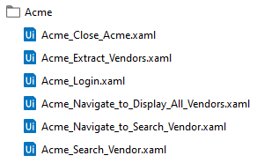
IDEATION
DISCOVERY
SOLUTIONING
IMPLEMENTATION
OPERATIONS
[CLIENT/BUSINESS]_[PROCESS] Ex. OTSC_AntiSpam
[APPLICATION]_[PROCESS] Ex. AntiSpam_Login
01
Processes
02
Workflows
NOMENCLATURE AGREEMENT
Notes:
Processes
Client/Business – refers to the business unit requesting for process automation.
Process – is the name of the process to be automated
Workflows
Client/Business – refers to the business unit requesting for process automation.
Process – is the name of the process to be automated

Slide 48
IDEATION
DISCOVERY
SOLUTIONING
IMPLEMENTATION
OPERATIONS
[APPLICATION]_[CREDENTIAL] Ex. AntiSpam_UserName, AntiSpam_Password
[PROCESS]_[ADDITIONAL INFO] Ex. AntiSpam_Daily10PM, AntiSpam_WeeklyTuesday
03
Credentials
04
Schedule
NOMENCLATURE AGREEMENT
Notes:
Credentials
Application – refers to the application where the robot will work
Credential – refers to username or password
Schedule
Process – is the name of the process to be automated
Additional Info – Refers to the information of the schedule

Slide 49
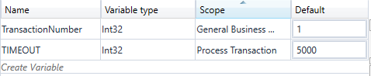
IDEATION
DISCOVERY
SOLUTIONING
IMPLEMENTATION
OPERATIONS
[PROCESS]_[ADDITIONAL INFO] Ex. AntiSpam_Robot1Environment, Antispam_TestingEnv
Ex. Variable: FirstName
Ex. Constant: MIDDLENAME
05
06
Variables and Constants
Environment
NOMENCLATURE AGREEMENT
Notes:
Environment
Process – is the name of the process to be automated
Additional Info – Refers to the information of the environment
Variables and Constants
These are components that we used in assigning values for strings and numbers needed in the process.

Slide 50
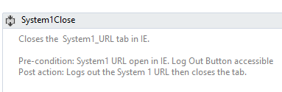
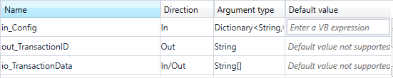
IDEATION
DISCOVERY
SOLUTIONING
IMPLEMENTATION
OPERATIONS
Ex. in_FirstName, out_LastName, io_MiddleName
07
Arguments
08
Annotations
NOMENCLATURE AGREEMENT
Notes:
Arguments
These are components that we used in assigning values for inputs and outputs for every workflow.
Annotations
These are descriptions of the workflow. Consists of : Main Description, Pre-Condition, Post Action.

Slide 51
IDEATION
DISCOVERY
SOLUTIONING
IMPLEMENTATION
OPERATIONS
dt_[VARIABLE NAME]
Ex. dt_TableReservation
dr_[VARIABLE NAME]
Ex. dr_TableReservation
09
Data Tables
10
Data Rows
NOMENCLATURE AGREEMENT
Notes:
Data Tables
These are variables containing lists or array of data.
Data Rows
These are variables containing lists or array of data.

Slide 52
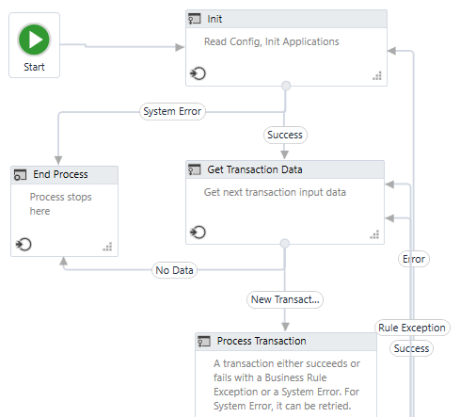
IDEATION
DISCOVERY
SOLUTIONING
IMPLEMENTATION
OPERATIONS
11
Robot Framework
END
NOMENCLATURE AGREEMENT
Notes:
Robot Framework
The main architectural framework we used for the Robot.

Slide 53
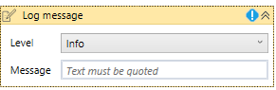
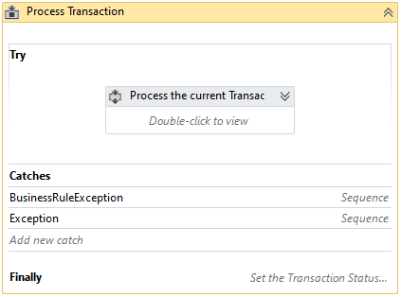
IDEATION
DISCOVERY
SOLUTIONING
IMPLEMENTATION
OPERATIONS
System Exceptions: includes processes not known to the robot; unexpected exceptions
Business Exceptions: Known exceptions
01
Logs
02
Try-catch
DEVELOPMENT GUIDELINES
Notes:
Logs
These are description on where in the process the Robot is working on. Levels: Trace, Info, Warning, Error, Fatal.
Try-Catch
All the identifiable scenario of the workflow that gives an error, should be handled using TRY-CATCH activity.

Slide 54
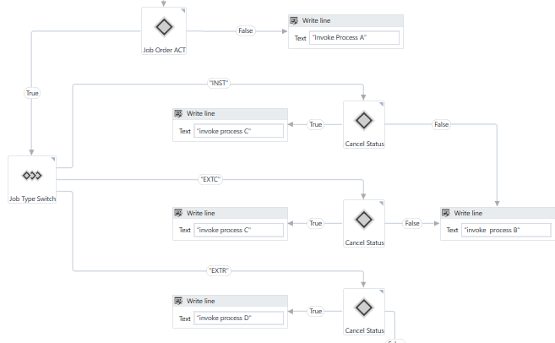
IDEATION
DISCOVERY
SOLUTIONING
IMPLEMENTATION
OPERATIONS
03
If-Statements
DEVELOPMENT GUIDELINES
Notes:
If-Statements
At least 2 nested if-else statement is allowed. Use flow decision instead of nested IF-ELSE statements. You can also use IF-SELECT activity for multiple cases.

Slide 55
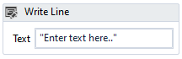
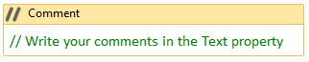
IDEATION
DISCOVERY
SOLUTIONING
IMPLEMENTATION
OPERATIONS
Write Activities and Message Activities
04
05
Comments
DEVELOPMENT GUIDELINES
Notes:
Write Activities and Message Activities
The Write Activity and Message Activity can be used for testing and debugging purposes. Activities that are not necessary for the production and delivery should be deleted.
Comments
Comments are used to put instructions in between activities.

Slide 56
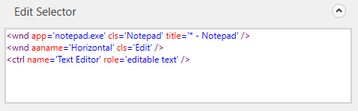
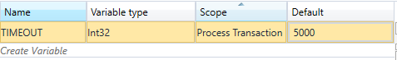
IDEATION
DISCOVERY
SOLUTIONING
IMPLEMENTATION
OPERATIONS
06
Selectors
07
Timeouts
DEVELOPMENT GUIDELINES
Notes:
Selectors
Selectors shall be configured to be dynamically accurate. You can use '*' and '?' to make it dynamic.
Timeouts
All timeouts, as much as possible, can be dynamically changed.

Slide 57
IDEATION
DISCOVERY
SOLUTIONING
IMPLEMENTATION
OPERATIONS
END
08
System Errors
09
Recovery
DEVELOPMENT GUIDELINES
Notes:
System Errors
System errors should be logged as Unhandled Exception in Log Message and / or in Excel or Google Sheet logs.
Recovery
All errors Login activities in the Initialization Process should be included in the exception criteria and robot should try to recover in-case there is a process interruption.

Slide 58
IDEATION
DISCOVERY
SOLUTIONING
IMPLEMENTATION
OPERATIONS
01
Understandable Workflow
02
Reusable Workflow
MAINTAINABILITY
Notes:
Understandable Workflow
The workflow should be simple and can be easily understand.
Reusable Workflow
Workflow should be created in such a way that it can be reused in other projects.

Slide 59
IDEATION
DISCOVERY
SOLUTIONING
IMPLEMENTATION
OPERATIONS
03
Follow Proper Commenting
04
Easy Integration
MAINTAINABILITY
Notes:
Follow Proper Commenting
Easy Integration
The workflow created should be flexible in connecting with other workflows.

Slide 60
IDEATION
DISCOVERY
SOLUTIONING
IMPLEMENTATION
OPERATIONS
[INITIAL COMMIT] - initial version of the workflow
[BUG FIX] - update for the bug or error in the workflow
[CODE OPTIMIZE] - enhancement or optimization of the workflow.
05
Repository Guidelines
END
MAINTAINABILITY
Notes:
Repository Guidelines
In committing the files in the repository, you should follow the proper commenting.

Slide 61
IDEATION
DISCOVERY
SOLUTIONING
IMPLEMENTATION
OPERATIONS
All Arguments and Variables are used
01
02
Arguments Coverage
TEST DEFINITION
Notes:
All Arguments and Variables are Used
All the arguments used in a workflow or invoked workflow should be used.
Arguments Coverage
All in/out/inout parameters of a workflow (in a process map) should be covered when creating arguments.

Slide 62
IDEATION
DISCOVERY
SOLUTIONING
IMPLEMENTATION
OPERATIONS
System Exceptions: includes processes not known to the robot; unexpected exceptions
Business Exceptions: Known exceptions
Acceptance Criteria Coverage
03
04
Exceptions
END
TEST DEFINITION
Notes:
Acceptance Criteria Coverage
All items in the acceptance criteria (per user story) should pass the test. Meaning, all the expected output on a set of input should be met.
Exceptions
All possible exceptions like timeout, login error, etc. should be covered as well.

Slide 63
COURSE OUTLINE
01
Governance Model Overview
02
Development Best Practices
03
Agile Lifecycle
04
Documentation Workshop
05
Mini Quizzes or Post Exam

Slide 64

IDEATION
DISCOVERY
SOLUTIONING
IMPLEMENTATION
OPERATIONS
Agile
Lifecycle
Development, Delivery, Deployment

Slide 65
IDEATION
DISCOVERY
SOLUTIONING
IMPLEMENTATION
OPERATIONS
1
Product Owner (s)
2
Scrum Master (s)
RPA Developers
- RPA Lead Developer
- RPA Developers
4
3
RPA Testers
- RPA Testers (ISG)
- RPA Testers (TCOE)
ROLES

Slide 66
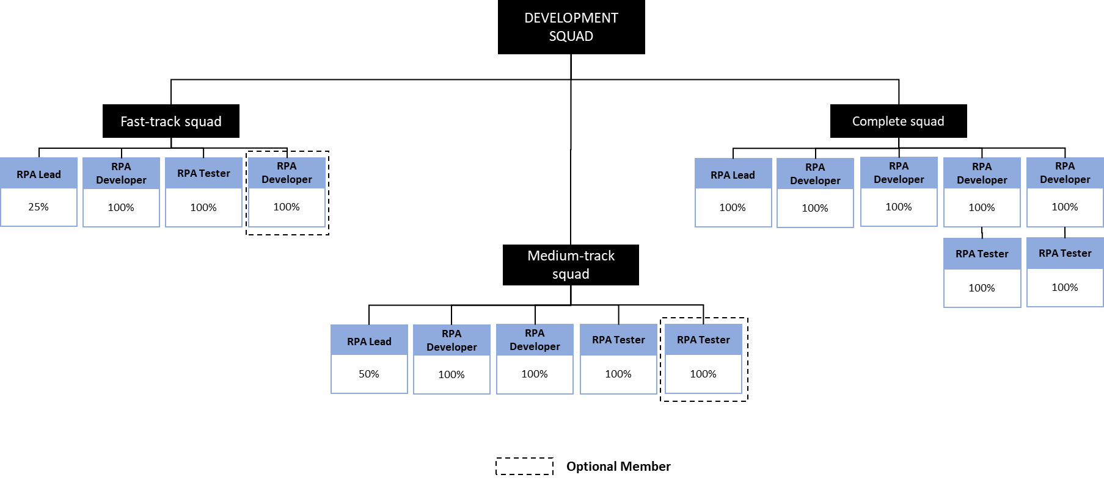
IDEATION
DISCOVERY
SOLUTIONING
IMPLEMENTATION
OPERATIONS
TEAM COMPOSITION
Notes:
Agile Ceremonies
Sprint 0
Sprint Planning
Sprint X
Review and Retro

Slide 67
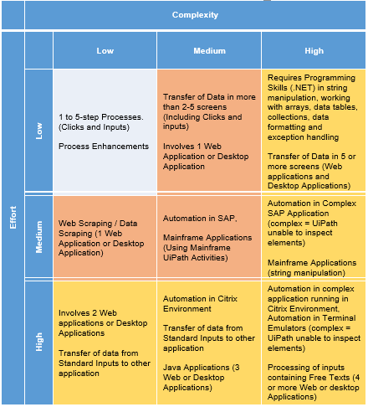
IDEATION
DISCOVERY
SOLUTIONING
IMPLEMENTATION
OPERATIONS
COMPLEXITY MATRIX

Slide 68
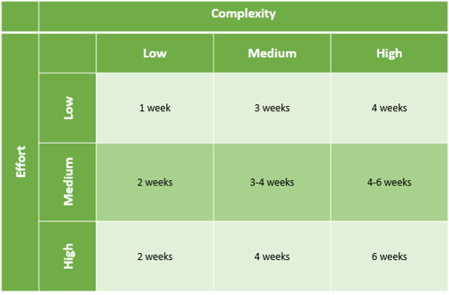
IDEATION
DISCOVERY
SOLUTIONING
IMPLEMENTATION
OPERATIONS
COMPLEXITY TIMELINE

Slide 69








IDEATION
DISCOVERY
SOLUTIONING
IMPLEMENTATION
OPERATIONS
Review and retrospective
Sprint x
SPRINT planning
Sprint 0
AGILE CEREMONIES
Notes:
Agile Ceremonies
Sprint 0
During the start of a new product or project, it is highly recommended to create a Definition of Ready which involves a series of activities and/or preparations as a foundation needed by the Scrum team to proceed with the actual development work.
Product Planning
Establishment of the Orchestrator and the environment where the robot will work on upon deployment.
Sprint Planning
The work to be performed in the Sprint is planned during Sprint Planning.
Sprint X
Review and Retro

Slide 70
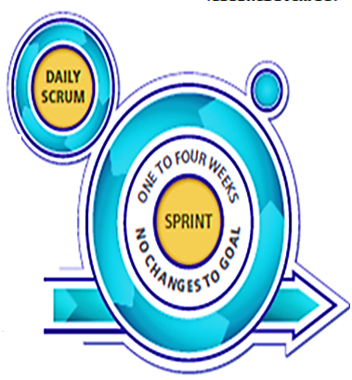
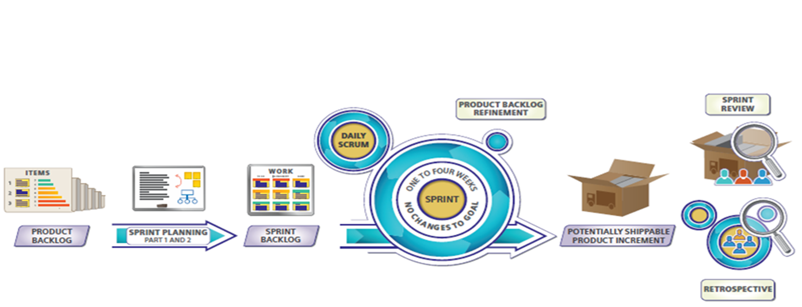
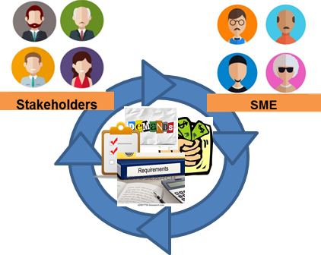
Re-prioritization
Updated Sprint Backlog
Raise Issues
Report Progress
Demo Delivery Acceptance
PRODUCT BACKLOG REFINEMENT
SDD (Initial)
Infra Requests
Credentials
DoR
SPRINT REVIEW
Potentially Shippable Product Increment
Sprint 0
PRODUCT BACKLOG
Sprint Planning
SPRINT BACKLOG
Development Test Case
UAT Test Case
DoD
SDD (Final)
ODH
Release Notes
Robot Package
RETROSPECTIVE
Action Items for the next Sprint
Lessons Learned

Slide 71
COURSE OUTLINE
01
Governance Model Overview
02
Development Best Practices
03
Agile Lifecycle
04
Documentation Workshop
05
Mini Quizzes or Post Exam

Slide 72

IDEATION
DISCOVERY
SOLUTIONING
IMPLEMENTATION
OPERATIONS
Documentation Workshop
SDD, ODH, Release Notes

Slide 73


IDEATION
DISCOVERY
SOLUTIONING
IMPLEMENTATION
OPERATIONS
Technical Definition of the automated process
SDD
To-Be
SOLUTION DESIGN DOCUMENT
Notes:
The SDD represents the To-be process – the process to be executed by the robot

Slide 74




IDEATION
DISCOVERY
SOLUTIONING
IMPLEMENTATION
OPERATIONS
INTRODUCTION
REQUIREMENTS
Pre-Development
DIAGRAMS &
DESCRIPTION
SOLUTION DESIGN DOCUMENT
Notes:
Introduction – description of the process and the scope of the process
Requirements – all requirements so that the robot is able to execute the process defined in SDD
Diagrams and Description – To-be process workflow and all the activities used in the project

Slide 75



IDEATION
DISCOVERY
SOLUTIONING
IMPLEMENTATION
OPERATIONS
ALERTS &
EXCEPTIONS
DATA &
CREDENTIALS
SECURITY
Pre-Development
ASSISTED
AUTOMATION
PROTOCOL
SOLUTION DESIGN DOCUMENT
Notes:
Alerts & Exception – what steps robot to take once alerted / exception encountered
Data & Credentials Security – file location, data storage robots would need to execute the process and how credentials are stored
Assisted Automation Protocol – for assisted automation, include trigger points of robots, all the inputs/outputs needed for the robot to execute the process

Slide 76

IDEATION
DISCOVERY
SOLUTIONING
IMPLEMENTATION
OPERATIONS
MANAGEMENT
INFORMATION
REPORT
Pre-Development
SOLUTION DESIGN DOCUMENT
Notes:
Management Information Report – customized report to be generated by robot

Slide 77



IDEATION
DISCOVERY
SOLUTIONING
IMPLEMENTATION
OPERATIONS
PROJECT
INFORMATION
OTHER
DETAILS
Post-Development
POST-UAT
SPECIFICATIONS
SOLUTION DESIGN DOCUMENT
Notes:
Project Information – projects and the workflows – and inputs and outputs – in each projects
Other Details – possible improvements in the automated projects, debugging tips
Post-UAT Specifications – results of UAT – AHT of robot, target number of robot to reach x number of transactions

Slide 78

IDEATION
DISCOVERY
SOLUTIONING
IMPLEMENTATION
OPERATIONS
GLOSSARY
Post-Development
SOLUTION DESIGN DOCUMENT
Notes:
Glossary – terminologies within the document

Slide 79


IDEATION
DISCOVERY
SOLUTIONING
IMPLEMENTATION
OPERATIONS
OPERATIONS
MANUAL
DEPLOYMENT
GUIDE
ODH
COMPONENTS
INFORMATION
OPERATION AND DEPLOYMENT HANDBOOK
Notes:
ODH:
Operations Manual – document contains information on how to start /
Deployment Guide – requirements before process gets deployed to production
Components Information – description of all the workflow within the project

Slide 80



IDEATION
DISCOVERY
SOLUTIONING
IMPLEMENTATION
OPERATIONS
VERSION
CONTROL
ROBOT/S
ODH
RUNTIME
GUIDE
OPERATION AND DEPLOYMENT HANDBOOK
Notes:
Version Control – previous versions references
Robot/s – how to monitor health of robot that would execute the process
Runtime Guide – diagram of relationship between components and information of the master project

Slide 81


IDEATION
DISCOVERY
SOLUTIONING
IMPLEMENTATION
OPERATIONS
CONTACTS
IMPLEMENT
ODH
DEFINITIONS
OPERATION AND DEPLOYMENT HANDBOOK
Notes:
Contacts
Business Operation Team – key person within the Business Operation Team that would conduct tests and has decision making power with re: to the implementation of RPA
RPA Delivery Team – RPA developers
Support and Operation Team – person/s that would do the deployment and would support the deployed process in production

Slide 82


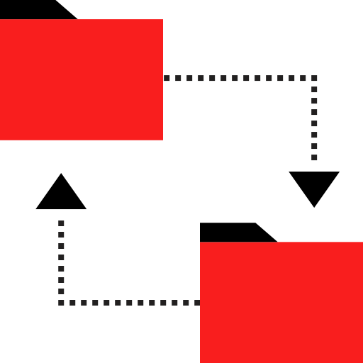

IDEATION
DISCOVERY
SOLUTIONING
IMPLEMENTATION
OPERATIONS
References of the previous RN
and ODH
Changes /
new features
RN
Information / Description
of the package
RELEASE NOTES

Slide 83


IDEATION
DISCOVERY
SOLUTIONING
IMPLEMENTATION
OPERATIONS
PROJECT/CHANGE
REFERENCE
RN
RELEASE
INFORMATION
RELEASE
CONTENTS
RELEASE NOTES
Notes:
Project/Change Reference
Release Date – date when the package will be released
Release Package Reference – version of the package
Changes Description – features / changes / new features in the package
Release Information
Package Name – name of the package published
Package Date Created – date when the package was published
Release Name – number of the release
Release Date Created – date when the release (compressed package & documents) is created
Release By – name / name of team that released the package
Released For – name of the BU / team that owns the process
Release File Location – location where the release is located
Release Contents
Name – name of the new or changed workflow/s
Changes / new features in the workflow – steps to resolve conflicts

Slide 84


Slide 85
Icons included in the PPT: Icon made by Prosymbols from www.flaticon.com Icon made by mynamepong from www.flaticon.com Icon made by Smashicons from www.flaticon.com Icon made by Alfredo Hernandez from www.flaticon.com Icon made by Eucalyp from www.flaticon.com Icon made by dDara from www.flaticon.com Icon made by Vectors Market from www.flaticon.com Icon made by itim2101 from www.flaticon.com Icon made by Vitaly Gorbachev from www.flaticon.com Icon made by Kiranshastry from www.flaticon.com Icon made by Pixel Buddha from www.flaticon.com Icon made by Phatplus from www.flaticon.com Icon made by Roundicons from www.flaticon.com Icon made by srip from www.flaticon.com Icon made by Dinosoftlabs from www.flaticon.com Icon made by Freepik from www.flaticon.com

